Slide 1
STR: A Simple and Efficient Algorithm for R-Tree Packing

Slide 2
Overview
R Tree Packing
Nearest –X
Hilbert Sort
Sort –Tile Recursive
Results

Slide 3
Packing
Disadvantages of inserting one element at a time into a R-Tree :
  High load time
  Suboptimal space utilization
  Poor R-Tree structure
Preprocessing advantageous for static data
Nearly 100% space utilization and improved query times

Slide 4
R-Tree Packing Algorithms
Nearest X
Hilbert Sort
Sort-Tile-Recursive

Slide 5
Basic Algorithm
Preprocess the data file so that the T rectangles are
ordered in [r/b] consecutive groups of b rectangles,
where each group of b is intended to be placed in
the same leaf level node.
Load the [r/bl groups of rectangles into pages and
output the (MBR, page-number) for each leaf level
page into a temporary file.
Recursively pack these MBRs into nodes at the
next level, proceeding upwards, until the root node
is created.

Slide 6
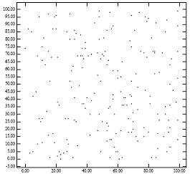
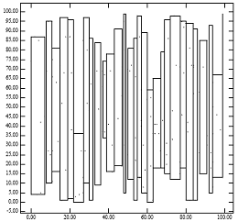
Nearest-X
Rectangles are sorted by x-coordinate (center of the rectangle)
Rectangles are then ordered into groups
of size b.

Slide 7
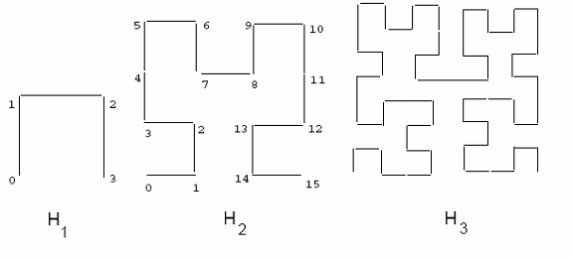
Hilbert Sort

Slide 8
Sort-Tile-Recursive
Sort the rectangles by x-coordinate and partition them into S vertical slices.
A slice consists of a run of S*b rectangles.
Sort the rectangles of each slice by y-coordinate.
Pack them into nodes by grouping them in size of b.
P = [r/b] S = √P
Notes:
P = [r/b]

Slide 9
Classes of Data
Uniformly distributed point and region data
Mildly skewed line segment data (TIGER)
Highly Skewed in location and size region data (VLSI)
Highly skewed, in terms of location, point data (CFD).
Notes:
For a buffer of size 10, HS requires 31 - 42% more disk accesses than STR for point data, and 26 - 32% more disk access for region data of
density 5. For a buffer of size 250, HS requires 33 -41% more disk access than STR for point data, and 26 - 32% more disk access for region data of density 5.
Note that as query region size increases, the difference between STR and HS becomes smaller (but STR always requires fewer disk accesses). This result is not surprising since the more data that needs to be retrieved the more naive the search algorithm can afford to be [3]. Carrying this argument to an extreme, if the query regions encloses all input data then no search needs to be performed: all

Slide 10
Uniformly Distributed Data
Hilbert sort 42% more disk accesses than STR for both point and range query.
NX algorithm performs well as well as STR
for point queries

Slide 11
Mildly skewed Data
HS algorithm requires up to 49% more disk accesses than STR for both point and region queries.
As region size increases, the difference between STR and HS becomes smaller.

Slide 12
Highly Skewed Data
For region data, HS performed 3% - 11% faster than STR for point queries and roughly the same for region queries.
For point data, HS required 11- 68% more disk access than STR for point queries, and roughly the same for region queries.

Slide 13
Conclusions
All algorithms based on heuristics
None of them is best for all datasets
NX is not competitive
Decision of using HS or STR is dependent on the type of the dataset
Importance of choosing a packing algorithm is diminished as either the query size or the buffer size increase

